Slide 1
Simplification implementation in France
Why and how ?
Marie Lambois

Slide 2

Why simplification ?
Priority dataset provider announcing that he has successfully created a dataset metadata that fully validates against the validator.
Image by wayhomestudio on Freepik

Slide 3

Why simplification ?
Same priority dataset provider when I announced him that now he has to create a download service with extended capabilities (so he cannot use his current software solution), a view service with extended capabilities and then he has to create a metadata for each service and in each metadata reference the dataset metadata so that the Inspire Geoportal understands that this service is serving this data and thus his data is advertised as downloadable/viewable.
Image by kues1 on Freepik

Slide 4

Why simplification ?
While in the meantime:
Data is shown as downloadable/viewable in the national data portal
Simplified approach has been used for years !

Slide 5
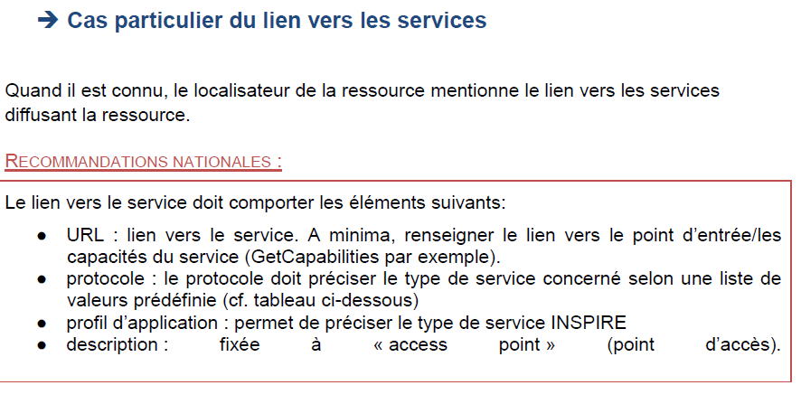
National Guidelines
http://cnig.gouv.fr/wp-content/uploads/2019/12/Guide-de-saisie-des-%C3%A9l%C3%A9ments-de-m%C3%A9tadonn%C3%A9es-INSPIRE-v2.0-1.pdf

Slide 6
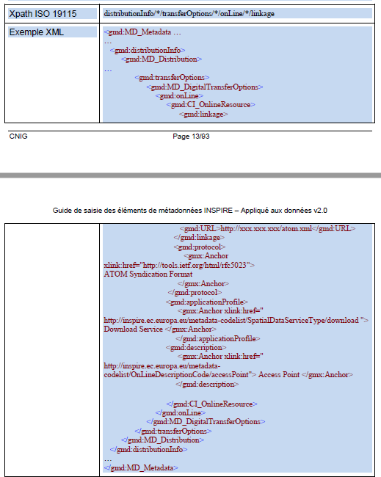
Based on URL, protocol, applicationProfile
A currently very sligthly different solution
(French guidelines published in 2019)
Will be aligned soon with the good practice simplification

Slide 7
MERCI DE VOTRE ATTENTION

